Slide 1


Pyrotechnic Devices Safety Training
Things to Consider
Pyrotechnic Functions
Safety Hazards
Handling Precautions
Pyrotechnics Regulation

Slide 2
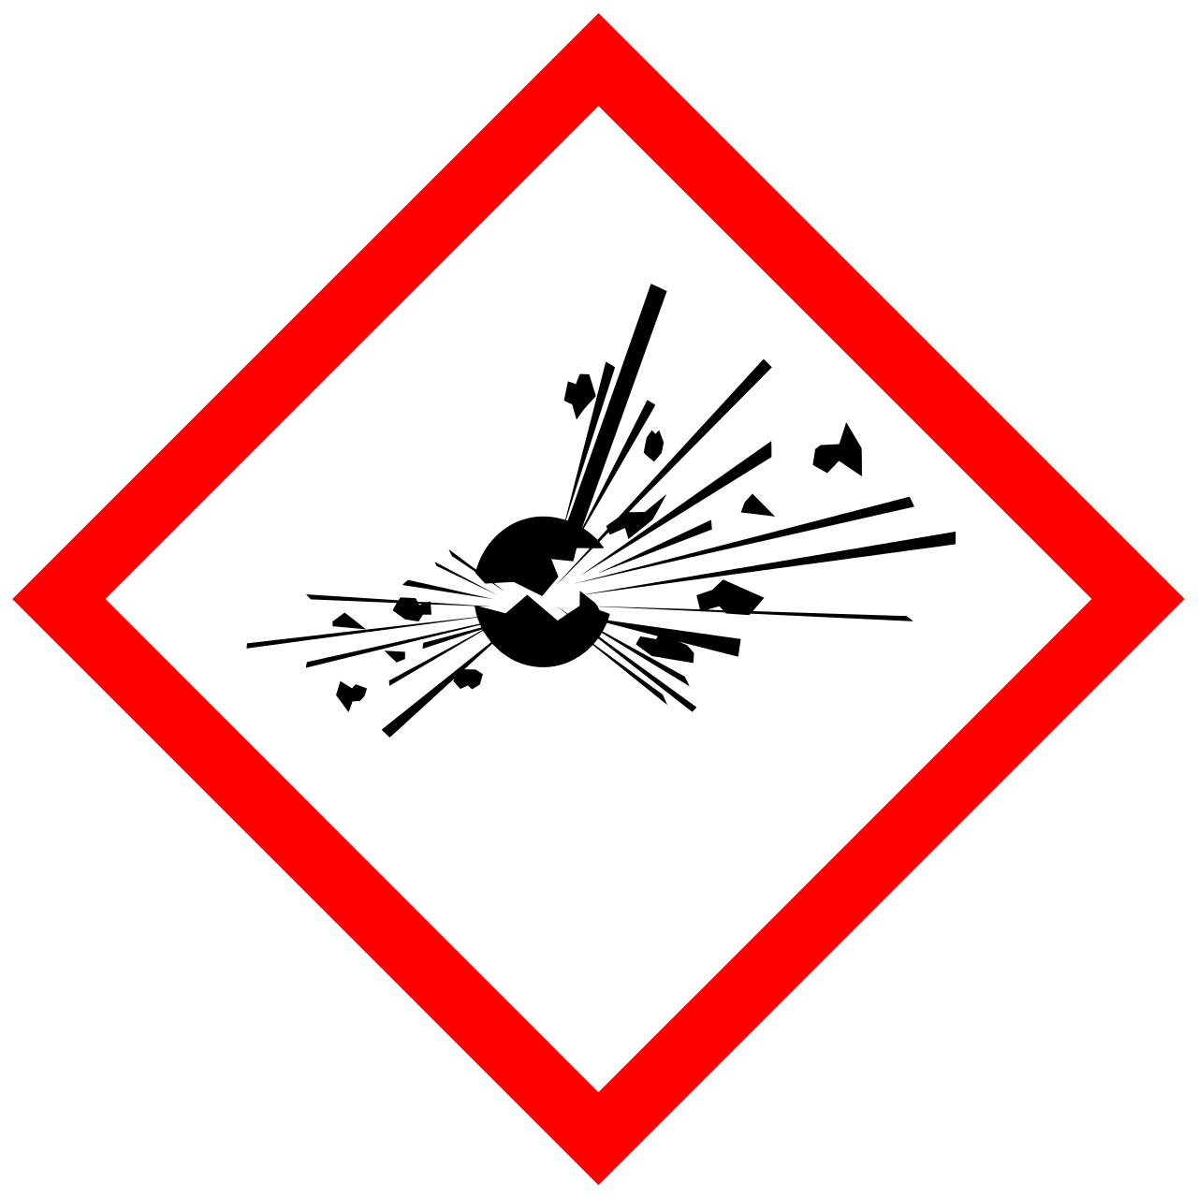
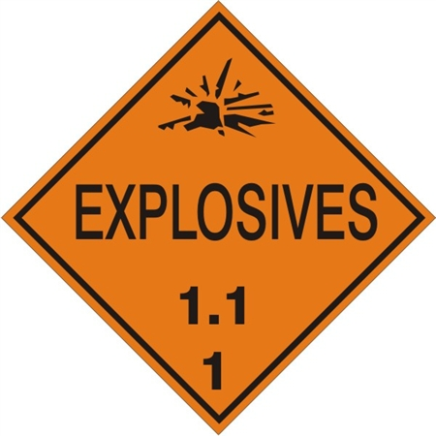
Things to Consider
Minimize using pyrotechnics if practical
Using 1.1 explosives are prohibited for the competition (e.g. mercury fulminate, rocket motors, explosive boosters, etc.)

Slide 3
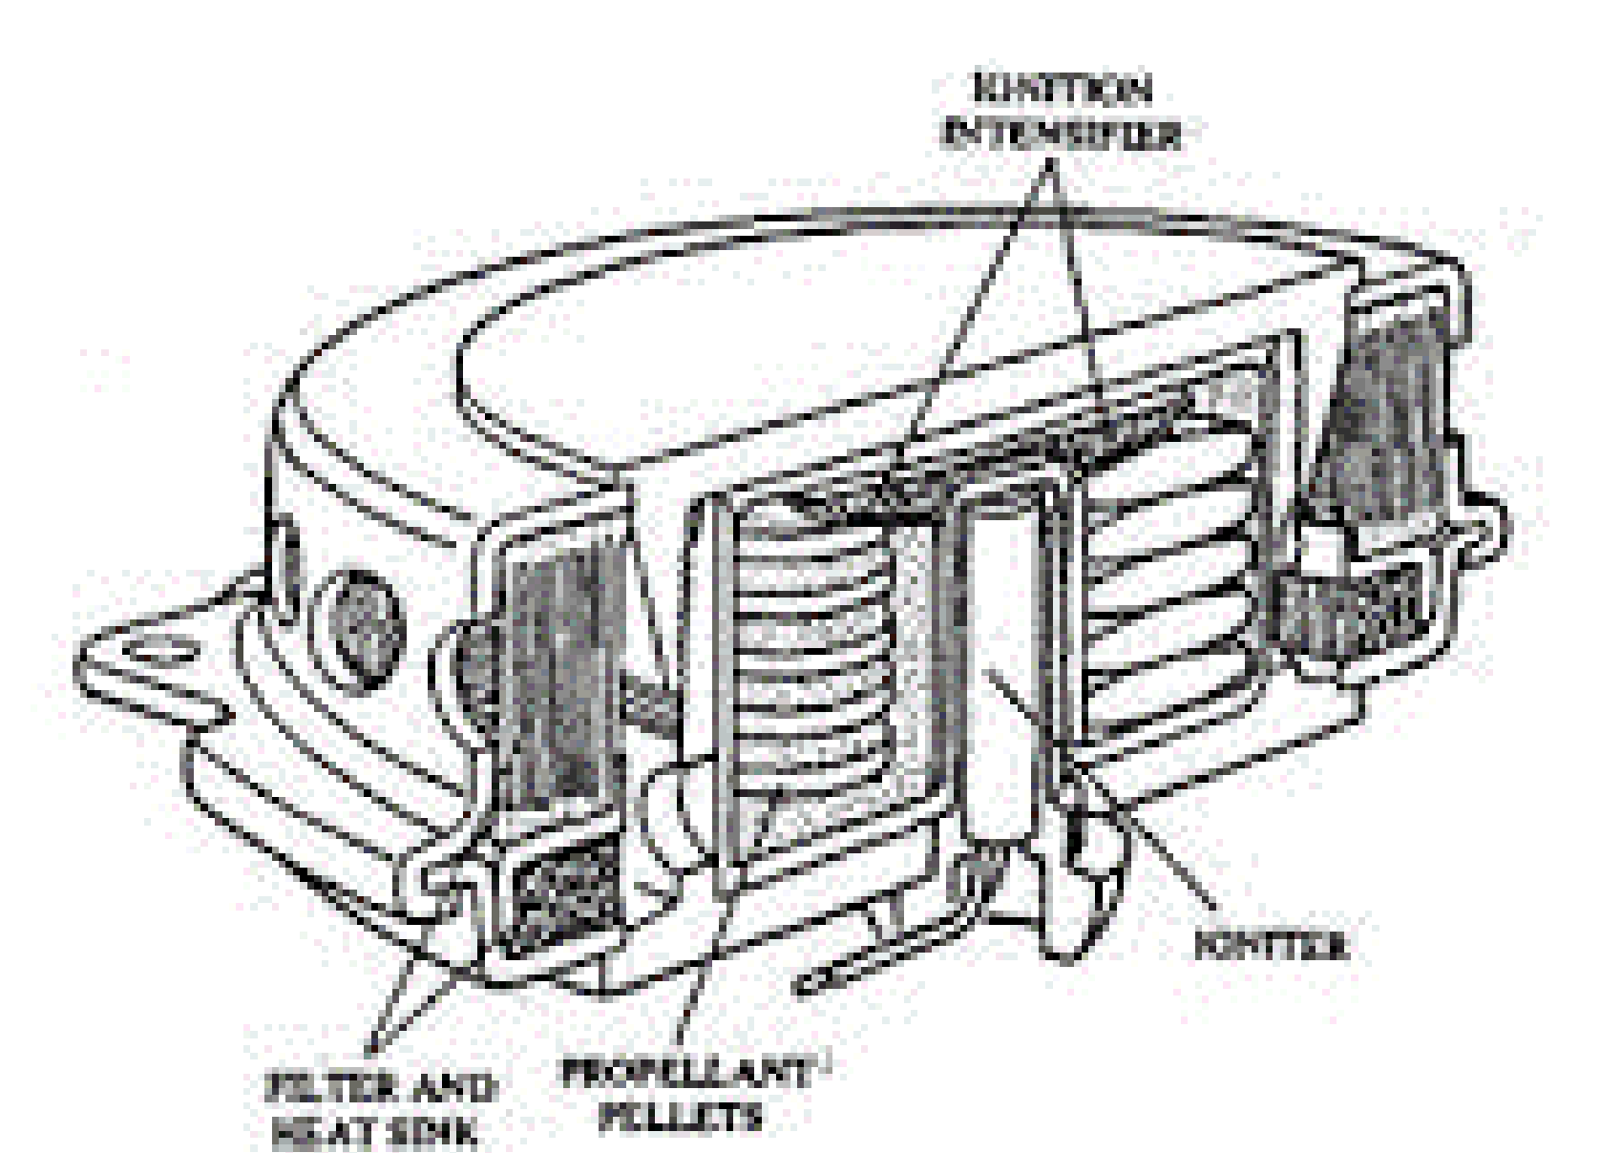
Pyrotechnic Functions
Pyrotechnics:
Detonations to destroy or break things
Flame generators for engine ignition
Grouped as: explosives (e.g. dynamite, nitroglycerine, TNT) and propellants (e.g. LOX, LNG)
How Pyrotechnic Devices Work?
Two or more major components: igniter, booster, pyrotechnic-charge
Igniter: starts the reaction with electric ignition
Booster: increases the effect of the igniter to initiate pyrotechnic-charge
Pyrotechnic-charge: detonation, gas/pressure, flame, smoke

Slide 4
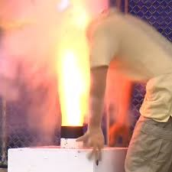
Safety Hazards
Injury or death caused by:
- intense flames causing burns
- smoke causing lung irritation and poisoning
- blast waves causing trauma
- shrapnel causing penetration
Safety Precautions:
- static discharge
- radio frequency
- stray current or voltage
- mechanical:
- impact, penetration, crush, damage, cut

Slide 5
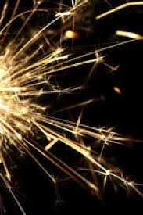
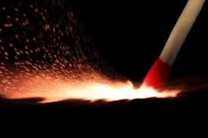
Safety Hazards
Safety precautions (cont.):
- sparks
- heat
- fire
- friction
- chemical reactions
- age

Slide 6
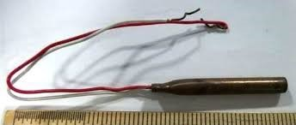
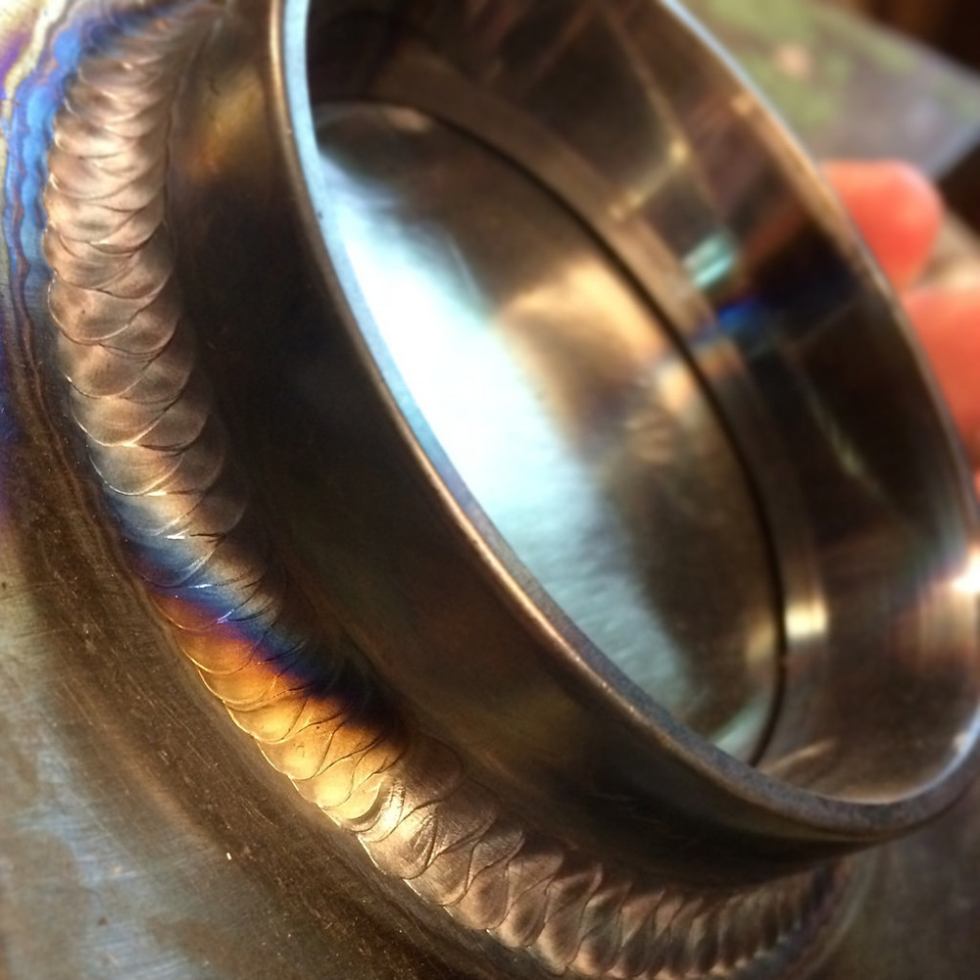
Handling Precautions
Prevent: cuts, dropping, crushing, or damage
Short igniter leads
- reduces sensitivity to static discharge or radio frequency
No smoking, sparks, or flames within 50-ft
Eliminate stray current or voltage
- disconnect batteries before the igniter is connected
Avoid devices that show signs of corrosion, chemical separation, or discoloration
Transport in rigid containers to prevent damage and crushing
Destroy all old or damaged pyrotechnic devices

Slide 7

Pyrotechnics Regulation
Requires Low Explosives Users Permit
Requires Explosives Magazine
- permit through the fire department
- protection from damage, fire, and theft
For more information, see
https://www.atf.gov/explosives

